Slide 1

Direct Marketing Campaign Analysis
Uncovering Actionable Insights for Future Strategies
Prepared By Helen Mehari Tefera
Institution: Portuguese Banking Institution
Date May 25, 2025

Slide 2

Project Overview
Analyzing a phone-based marketing campaign by a bank.
Goals
Find out what worked and what didn't
Identify key patterns and recommend actionable strategies.

Slide 3
Understanding Our Campaign & Analysis Goals
Content:
Campaign Context: Phone-based outreach by a Portuguese banking institution to promote term deposits.
Project Goal: To analyze campaign data, extract meaningful patterns, and provide actionable insights to optimize future marketing efforts.
Key Questions Addressed:
Who are our most receptive clients?
What factors influence subscription?
How can we improve conversion rates?

Slide 4
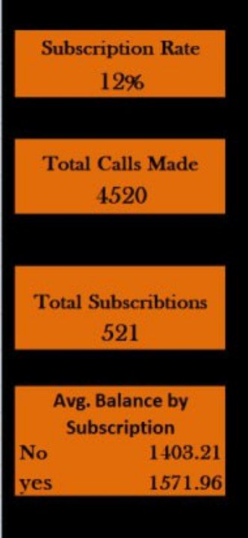
Our Approach and Data Overview
Data Source: Dataset from a direct marketing campaign (bank.csv).
Tools Used: Exploratory Data Analysis (EDA) performed in Excel, with insights visualized in an interactive Excel Dashboard.

Slide 5
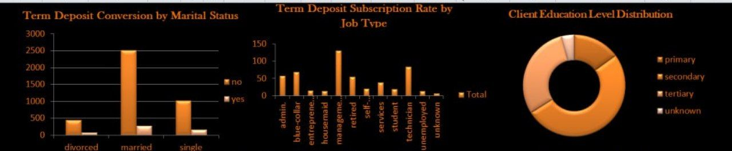
Who is Responding? Client Profile Insights
Visualization 1:
Insight: Our analysis reveals that married clients show the highest conversion rates, significantly outperforming single or divorced individuals.
Visualization 2:
Insight: We identified specific job types, such as retired and student segments as particularly receptive to term deposit offers, while 'blue-collar workers’ showed lower engagement.
Visualization 3 :
Insight: Understanding our client's education levels 'predominantly secondary educated' helps us tailor communication complexity."

Slide 6
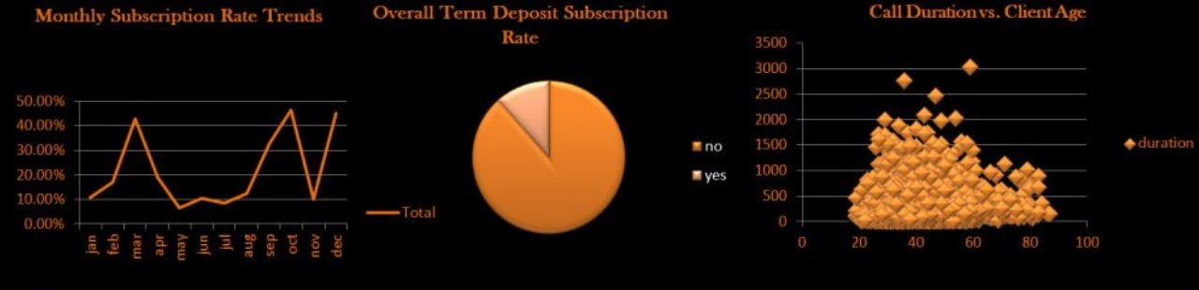
Campaign Performance: Trends & Call Effectiveness
Visualization 1:
Insight: Subscription rates show significant monthly fluctuation, hitting
peaks in March, December, and particularly October (the highest),
while experiencing low points in April and September.
Visualization 2:
Insight: Overall subscription rate is low, with a small percentage opting in.
Visualization 3:
Insight: Most calls occur for clients aged 30-60, typically lasting under 1000 seconds.

Slide 7
Key Recommendations
Target Smarter: Prioritize high-converting segments married, Management Position and tailor messaging.
Optimize Campaign Timing: Leverage monthly trends by focusing efforts around peak periods (March, October and December).
Enhance Call Center Effectiveness: Implement agent training to improve call strategies and conversion rates.

Slide 8
Conclusion
Key Takeaway: Our analysis provides clear, actionable insights to optimize future direct marketing campaigns.
Next Steps: Implement targeted strategies to improve efficiency and increase term deposit subscriptions.

Slide 9
Thank You!

